Slide 1
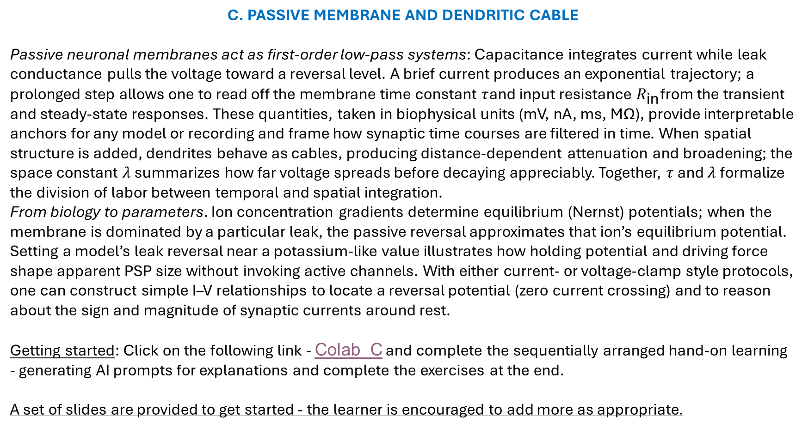
C. PASSIVE MEMBRANE AND DENDRITIC CABLE
Passive neuronal membranes act as first‑order low‑pass systems: Capacitance integrates current while leak conductance pulls the voltage toward a reversal level. A brief current produces an exponential trajectory; a prolonged step allows one to read off the membrane time constant $τ$and input resistance $R_{\text{in}}$from the transient and steady‑state responses. These quantities, taken in biophysical units (mV, nA, ms, MΩ), provide interpretable anchors for any model or recording and frame how synaptic time courses are filtered in time. When spatial structure is added, dendrites behave as cables, producing distance‑dependent attenuation and broadening; the space constant $λ$ summarizes how far voltage spreads before decaying appreciably. Together, $τ$ and $λ$ formalize the division of labor between temporal and spatial integration.
From biology to parameters. Ion concentration gradients determine equilibrium (Nernst) potentials; when the membrane is dominated by a particular leak, the passive reversal approximates that ion’s equilibrium potential. Setting a model’s leak reversal near a potassium‑like value illustrates how holding potential and driving force shape apparent PSP size without invoking active channels. With either current‑ or voltage‑clamp style protocols, one can construct simple I–V relationships to locate a reversal potential (zero current crossing) and to reason about the sign and magnitude of synaptic currents around rest.
Getting started: Click on the following link - Colab_C and complete the sequentially arranged hand-on learning - generating AI prompts for explanations and complete the exercises at the end.
A set of slides are provided to get started - the learner is encouraged to add more as appropriate.

Slide 2
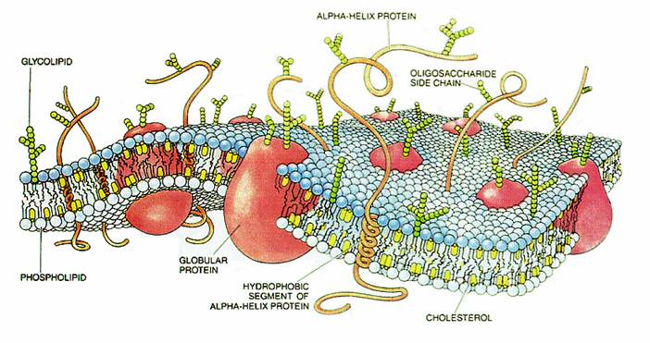
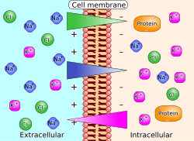
Now we connect to systems concepts: RC membrane, conductances, Nernst/Goldman, pumps as rechargers, τ, λ, HH intuition.
Colab for part B - https://colab.research.google.com/github/cyneuro/Chapter_Colabs/blob/main/Colab_B.ipynb
B1. Membrane as Capacitor + Leak as Resistor The bilayer stores charge (capacitance), while leak
channels provide conductive paths.
Together they produce RC‑like voltage time courses.
Self‑learning prompt: Using everyday analogies, explain why
membranes have capacitance and how leak affects voltage
over time. Predict the qualitative shape of V(t) to a small
current step.
B2. Ion Gradients as Batteries — Nernst Potentials
Each ion’s gradient corresponds to a reversal potential
via Nernst. Channel selectivity ties ion flow to driving force
Self‑learning prompt: Compute E_K and E_Na from given
concentrations. Explain how changing internal K⁺ or external
Na⁺ shifts the corresponding Nernst potentials.

Slide 3
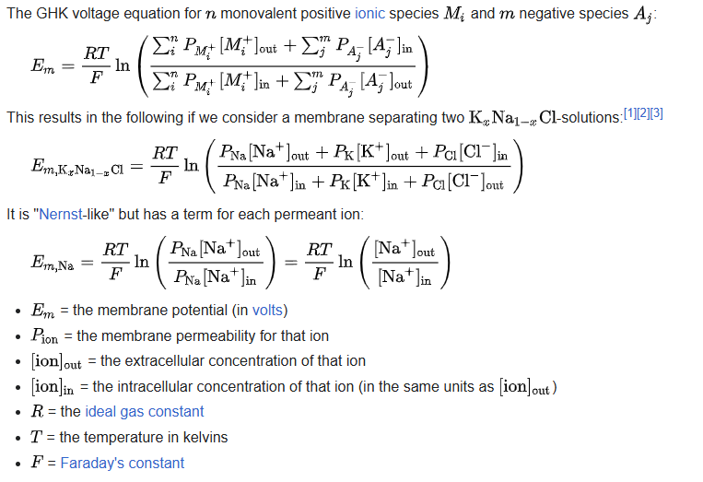
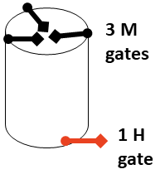
B3. Multiple Ions — Goldman–Hodgkin–Katz (GHK) and Resting Potential
With several permeant ions, resting V depends on relative permeabilities (P_K, P_Na, P_Cl), not just concentrations.
Self‑learning prompt:
Explain how changing
P_K/P_Na moves the
resting potential.
Provide a qualitative
graph showing resting
V as P_K increases.
B4. Voltage‑Gated Channels — Activation & Inactivation (m, h, n) Na⁺ channels: activation (m) and inactivation (h); K⁺: activation (n). Their voltage dependence creates spikes via positive and negative
feedback loops.
Self‑learning prompt: Describe how m, h, and n change with depolarization and how that sequence produces an action potential’s rise and fall.

Slide 4
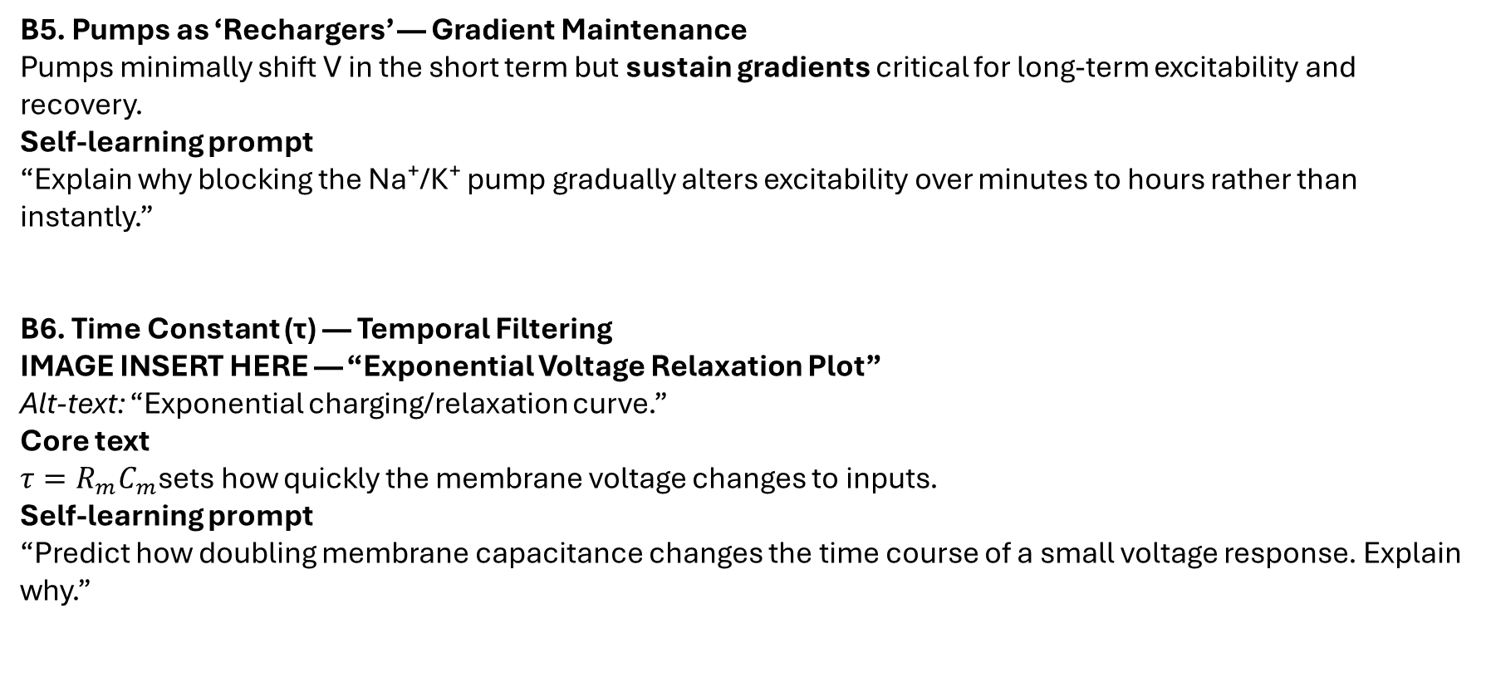
B5. Pumps as ‘Rechargers’ — Gradient Maintenance Pumps minimally shift V in the short term but sustain gradients critical for long‑term excitability and recovery.
Self‑learning prompt “Explain why blocking the Na⁺/K⁺ pump gradually alters excitability over minutes to hours rather than instantly.”
B6. Time Constant (τ) — Temporal Filtering
IMAGE INSERT HERE — “Exponential Voltage Relaxation Plot” Alt‑text: “Exponential charging/relaxation curve.”
Core text $τ=R_{m}C_{m}$sets how quickly the membrane voltage changes to inputs.
Self‑learning prompt “Predict how doubling membrane capacitance changes the time course of a small voltage response. Explain why.”

Slide 5
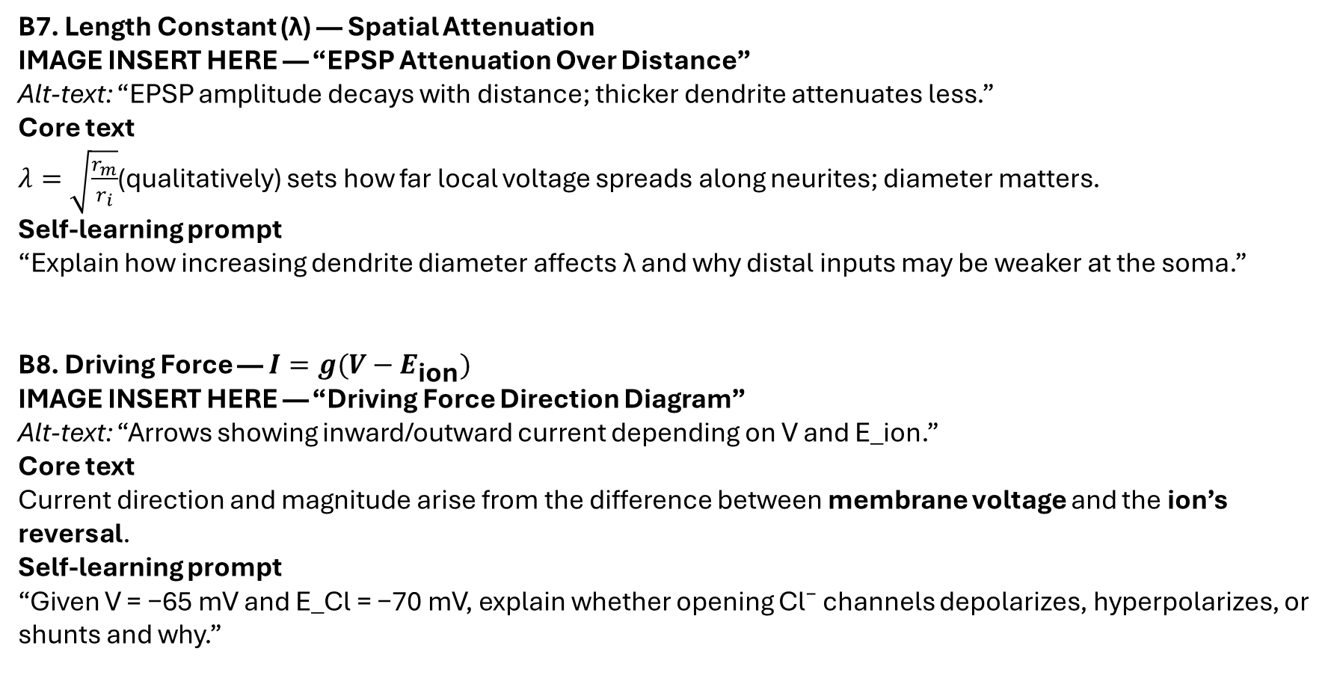
B7. Length Constant (λ) — Spatial Attenuation
IMAGE INSERT HERE — “EPSP Attenuation Over Distance” Alt‑text: “EPSP amplitude decays with distance; thicker dendrite attenuates less.”
Core text $λ=\sqrt{\frac{r_{m}}{r_{i}}}$(qualitatively) sets how far local voltage spreads along neurites; diameter matters.
Self‑learning prompt “Explain how increasing dendrite diameter affects λ and why distal inputs may be weaker at the soma.”
B8. Driving Force — $I=g(V−E_{\text{ion}})$
IMAGE INSERT HERE — “Driving Force Direction Diagram” Alt‑text: “Arrows showing inward/outward current depending on V and E_ion.”
Core text Current direction and magnitude arise from the difference between membrane voltage and the ion’s reversal.
Self‑learning prompt “Given V = −65 mV and E_Cl = −70 mV, explain whether opening Cl⁻ channels depolarizes, hyperpolarizes, or shunts and why.”

Slide 6
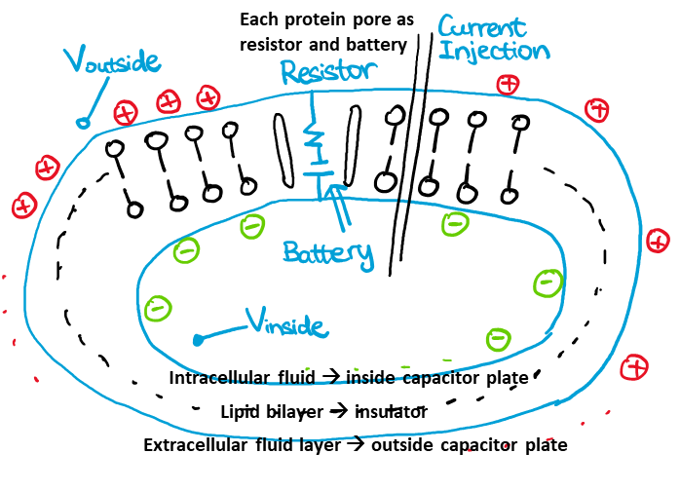
B9. Myelination — Changing Effective Membrane Properties Myelin reduces capacitance and increases resistance in internodes, enabling saltatory conduction between nodes.
Self‑learning prompt “Predict how demyelination affects signal propagation and threshold at nodes.”
B10. Hodgkin–Huxley in a Nutshell — The Membrane Equation The membrane equation combines capacitance, conductances, and driving forces into a time‑evolving voltage description used in simulators like NEURON.
Self‑learning prompt “In 4–6 sentences, map capacitor, conductances, and reversal potentials to biological elements and state the membrane equation qualitatively (no derivation).”

